Slide 1
Dentronics: Using Artificial Intelligence in Dentistry
Jamyla Young
FAMU / REU

Slide 2
Overview
Motivation
Challenges
Model
Results
Conclusion
Takeaway

Slide 3
Motivation
The motivation behind this project was to highlight the fast growing field of dentistry through the use of artificial intelligence to provide anatomic guidance, treatment planning, and treatment outcome evaluation.
This infers that more accurate and efficient diagnosis will be achieved with the integration of AI into existing dental clinical workflow
This allows for integration between data domains i.e medical history, imagery data, and sociodemographic data

Slide 4
Challenges
Overall, artificial intelligence has its limits in the dentistry field
Data is not as accessible due to data protection concerns.
Processing data, and measuring and validating results is oftentimes insufficiently replicable and robust in dental AI research.
The outcomes of AI is not readily available
Notes:
Hard to improve data quantity and quality. Establishing an open-access standard data set, which contains comprehensive demographic, clinical, experimental, and treatment data, would be a crucial task in the next stage of AI development to facilitate evaluation and comparison of different algorithms.

Slide 5
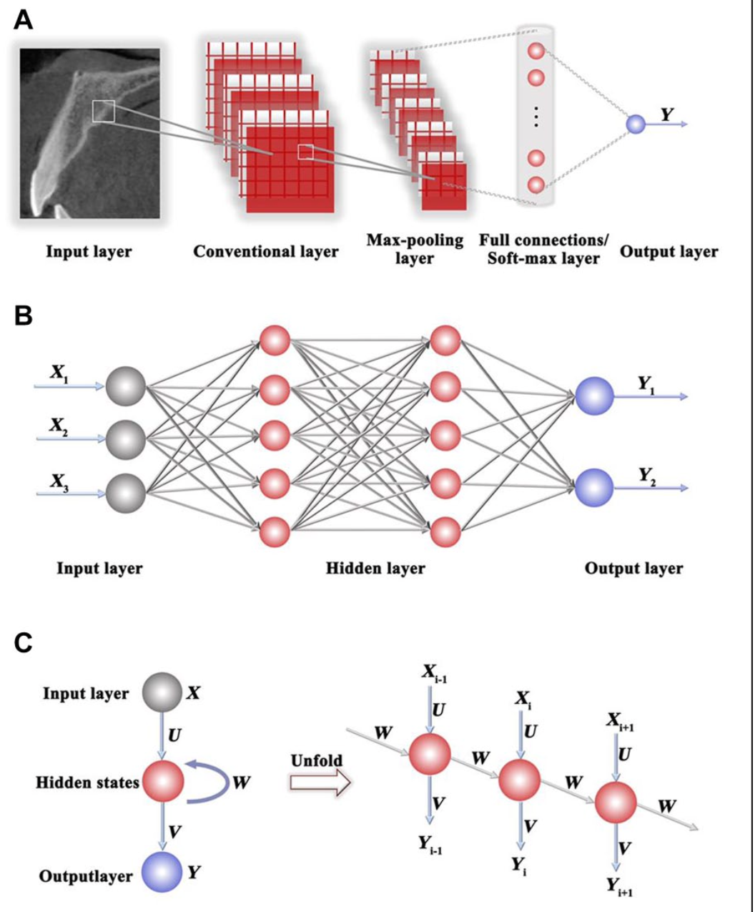
Topology of 3 artificial neural networks: (A) convolutional, (B) multilayer perceptron, and (C) recurrent. X_{i}, input data set; Y_{i}, output data set. U, V, and W are the weights.
Notes:
Data-driven AI or ML may be divided as supervised, unsupervised, and semisupervised learning (Handelman et al. 2018). On the supervised platform, algorithms employ manually labeled training data sets to learn the correlations between data instances and labels, yielding the desired and known outcomes.In unsupervised learning, algorithms are provided with unlabeled data, and they involve recognizing hidden data patterns that investigators may not have conceived, yielding unknown results.

Slide 6
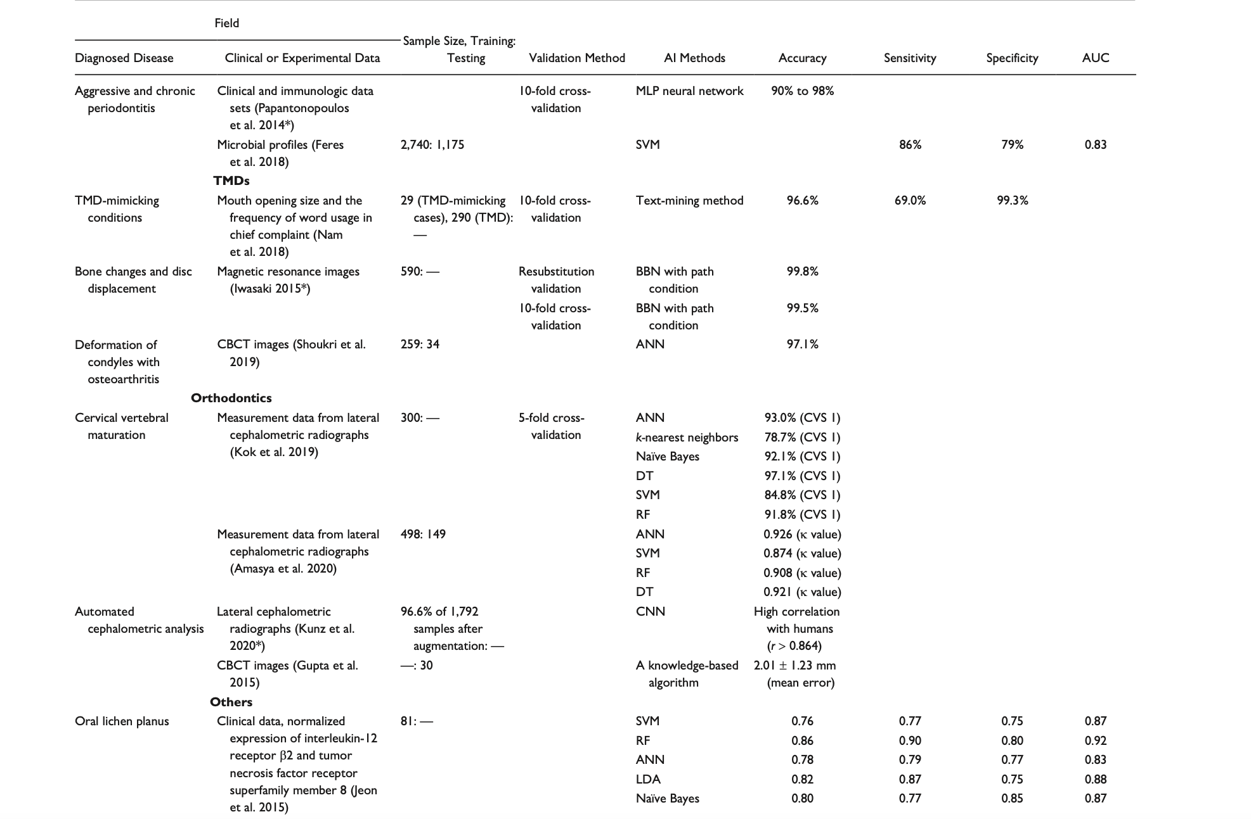
Results

Slide 7
Conclusion
AI is progressing rapidly, with potential applications in diagnosis, treatment, and prognosis predictions. Although road- blocks that arise from data acquisition, interpretation, computing power, and moral issues exist and need to be overcome, AI is perceived to be an excellent adjunct for dentists. With thoughtful design and long-term clinical validation, AI can be user-friendly, transparent, reproducible, and unbiased. Future AI development should continue to consider human interest as its primary mission, with increasing capability in handling big data.

Slide 8
Takeaway
My takeaway from this course is the ability to provide us students with data science tools and resources to increase students’ knowledge about machine learning. I enjoyed how hands on and informative each lecture was. Additionally, I enjoyed how supportive the mentors, professors, and peers were during this process. This connection made the REU experience fun!

Slide 9
Acknowledgement
I would like to give thanks to FAMU for providing me with a great opportunity to learn and connect with others in the midst of a pandemic. I would like to acknowledge my mentors, peers, and professors for giving me an insight into data science. I gained so much insight about machine learning.

